Slide 1
Tidyverse
Introduction to Computational CMB
Meg Hemmerlein
14 February 2024

Slide 2
Agenda
Monday
Wednesday
Dataframes
Dplyr & tidyr
Factors
Renaming
Converting
In-class problems
Homework

Slide 3
Wednesday Objectives
Learn about dplyr and tidyr
Learn about ’pipe’ operator %>%
Manipulate data using dplyr -- select, mutate, summarize, group_by, count
Learn about wide vs long table format
Manipulate data using tidyr -- reshape a data frame from long to wide and back using pivot_wider and pivot_longer
Let’s start!
Pull down GitHub Tidyverse
Open TidyverseDay2.Rmd

Slide 4
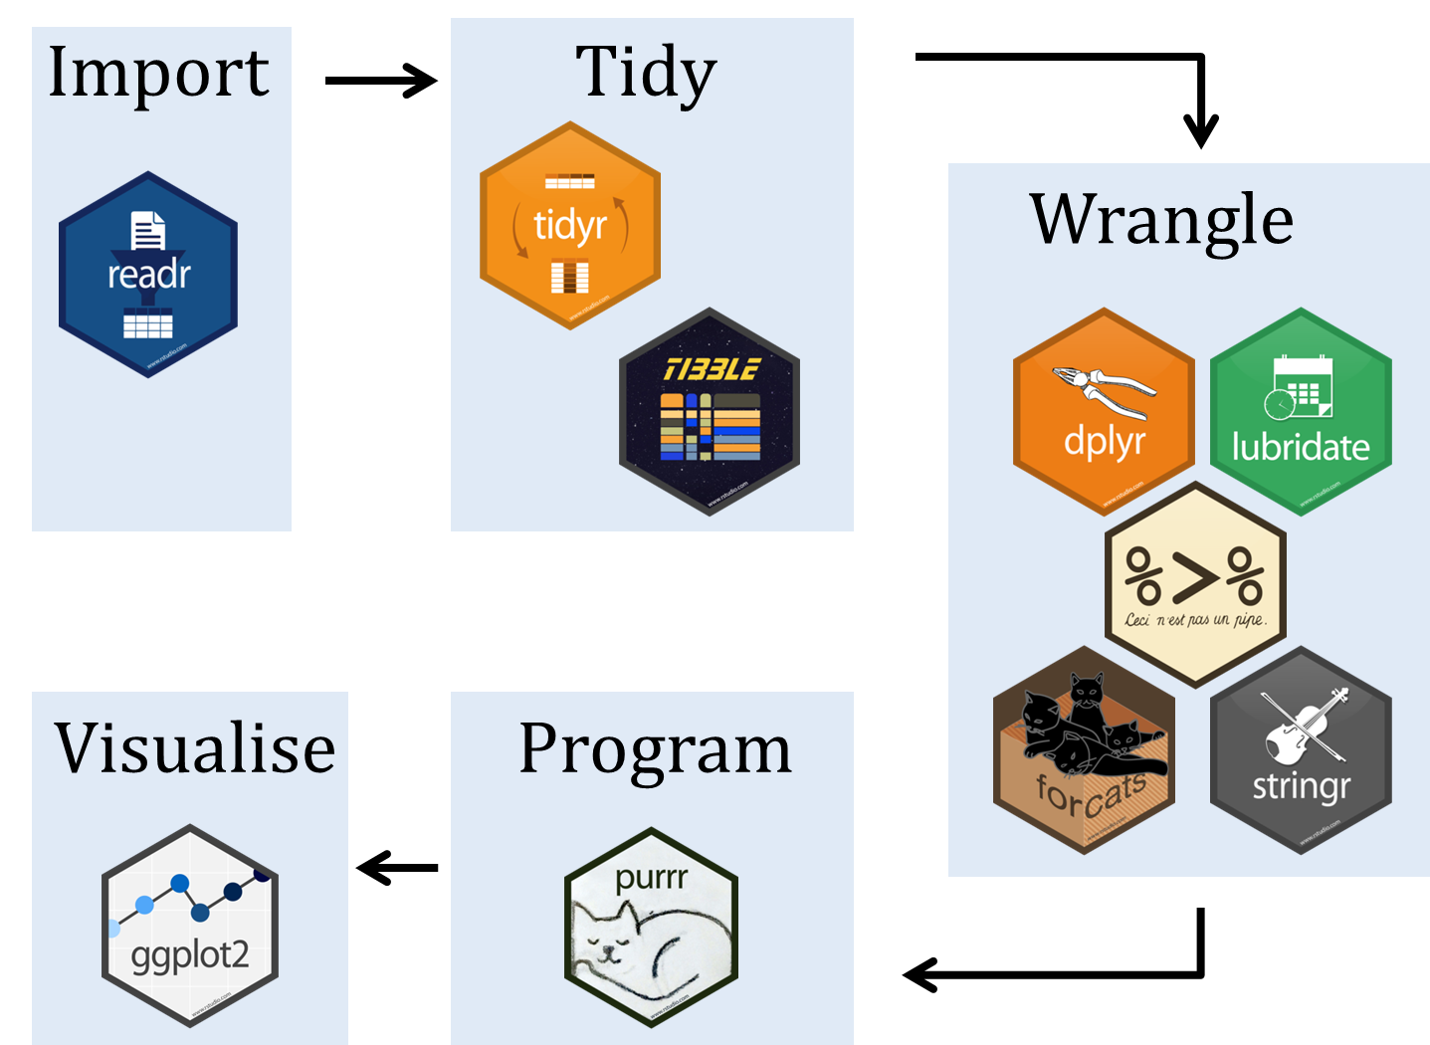

What is tidyverse?

Slide 5
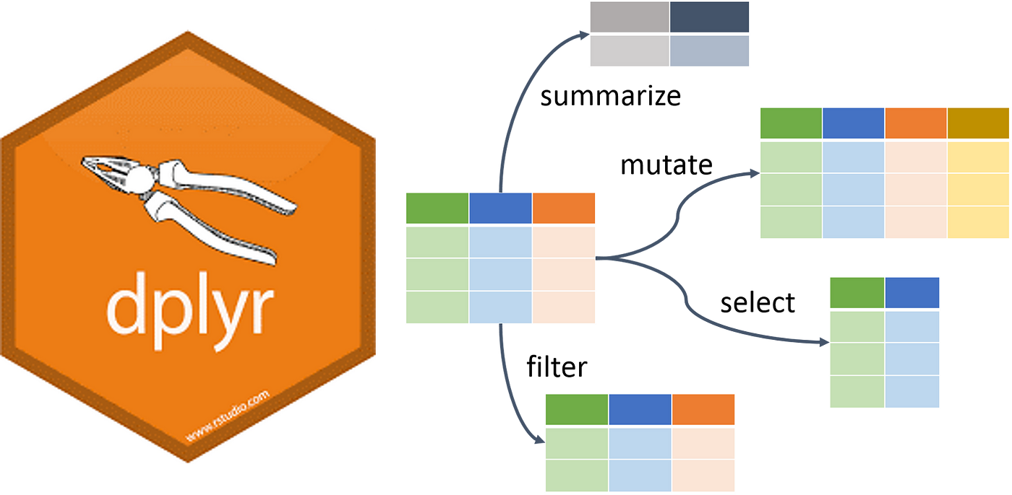
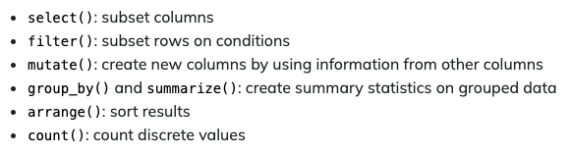
What is dplyr?

Slide 6

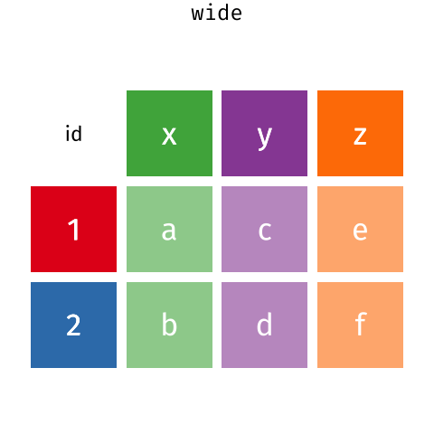
What is tidyr?

Slide 7

What are pipes? %>%
With dplyr we can perform a series of operations using pipes
Pipes will send the results of one function into another using the pipe operator (%>%)
One line of code is now equivalent to multiple

Slide 8
Dplyr: Selecting columns
Selecting columns of a data frame
Format: select(df, col1, col2)
Example
select(surveys, plot_id, species_id, weight)
Selecting all columns except certain ones
Format: select(df, -col1, -col2)
Example
select(surveys, -plot_id, -species_id, weight)

Slide 9
Dplyr: Filtering rows
Filtering rows
Format: filter(df, col1 == x)
Example
select(surveys, year == 1995)

Slide 10
Dplyr: Pipes
Selecting and filtering
surveys %>%
filter(weight < 5) %>%
select(species_id, sex, weight)
Piping shortcut!
Piping into new object
surveys_sml <- surveys %>%
filter(weight < 5) %>%
select(species_id, sex, weight)

Slide 11
Run chunk 1-8

Slide 12
Dplyr: Mutate
Creating new columns based on existing columns (for example, unit conversion or find the ratio between two columns)
To create a new column of weight in kg:
surveys %>%
mutate(weight_kg = weight / 1000)
To create a second column based off first new column:
surveys %>%
mutate(weight_kg – weight / 1000,
weight_lb = weight_kg * 2.2)

Slide 13
Dplyr: Mutate (No NAs)
To create a new column of weight in kg and view head:
surveys %>%
mutate(weight_kg = weight / 1000)
head()
The first few rows of the output have NAs in weight column, to remove those we could insert a filter in the chain:
surveys %>%
filter(!is.na(weight))%>%
mutate(weight_kg = weight / 1000)
head()

Slide 14
Run chunk 9-12

Slide 15
Dplyr: Group_by and summarize
Split-apply-combine paradigm: split the data into groups, apply some analysis to each group, and then combine the results
Group_by() is often used together with summarize(), which collapses each group into a single row summary of that group.
surveys %>%
group_by(sex) %>%
summarize(mean_weight = mean(weight, na.rm = TRUE))
Grouping multiple columns
surveys %>%
group_by(sex, species_id) %>%
summarize(mean_weight = mean(weight, na.rm = TRUE))
tail()

Slide 16
Run chunk 13-14

Slide 17
Dplyr: Group_by and summarize NaN?? NA? What the heck.
The sex column contains NA values because some animals had escaped before their sex and body weights could be determined
The resulting mean_weight column does not contain NA but NaN (“Not a Number”) because mean() was called a vector of NA values while at the same time setting na.rm = TRUE.
To avoid this, we can remove the missing values for weight before we attempt to calculate the summary statistics on weight.
Because the missing values are removed first, we can omit na.rm = TRUE when computing the mean.
Let’s fix this …

Slide 18
Dplyr: Group_by and summarize Fixing NA values
Filter out NAs from weight column and then summarize (no need for na.rm = TRUE)
surveys %>%
filter(!is.na(weight)) %>%
group_by(sex, species_id) %>%
summarize(mean_weight = mean(weight))

Slide 19
Run chunk 15

Slide 20
Dplyr: Group_by and summarize Summarizing multiple variables
Summarizing multiple variables at the same time
For example, adding a column indicating minimum weight for each species of sex
surveys %>%
filter(!is.na(weight)) %>%
group_by(sex, species_id) %>%
summarize(mean_weight = mean(weight),
min_weight = min(weight))

Slide 21
Dplyr: Group_by and summarize Descending order
To sort a column in descending order, we need to add desc() function. For example, sorting the results by decreasing order of mean weight
surveys %>%
filter(!is.na(weight)) %>%
group_by(sex, species_id) %>%
summarize(mean_weight = mean(weight),
min_weight = min(weight)) %>%
arrange(desc(mean_weight))

Slide 22
Dplyr: Counting
If we want to know the number of observations found for each factor or combinations of factors, we can use count().
surveys %>%
count(sex)
To count a combination of factors
surveys %>%
count(sex, species)
To count a combination of factors AND sort output
surveys %>%
count(sex, species)%>%
arrange(species, desc(n))

Slide 23
Run chunk 18-20

Slide 24
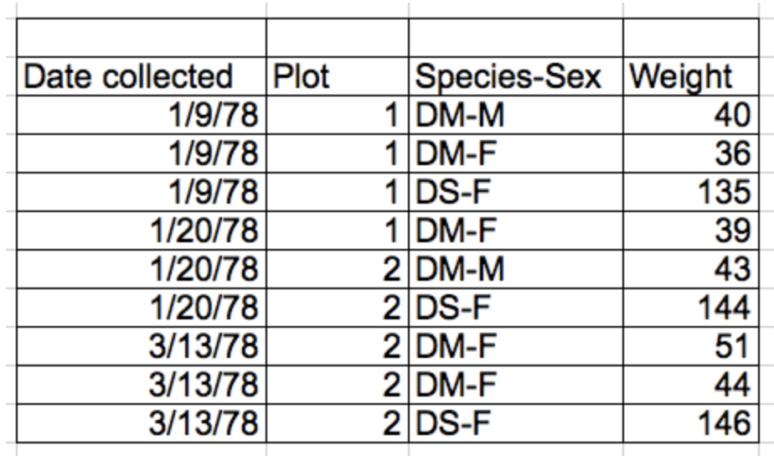
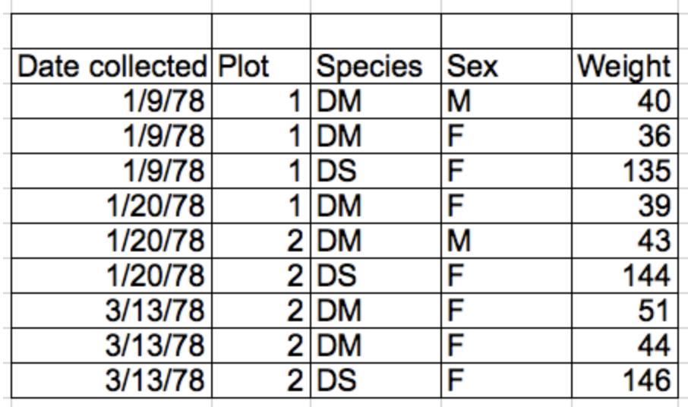
Tidy Data
Rules defining tidy data:
Each variable has its own column – thing you are measuring
Each observation has its own row
Each value must have its own cell – don’t combine data in a single cell!
Leave the raw data raw
Each type of observational unit forms a table
columns = variables, rows = observations, cells = data

Slide 25
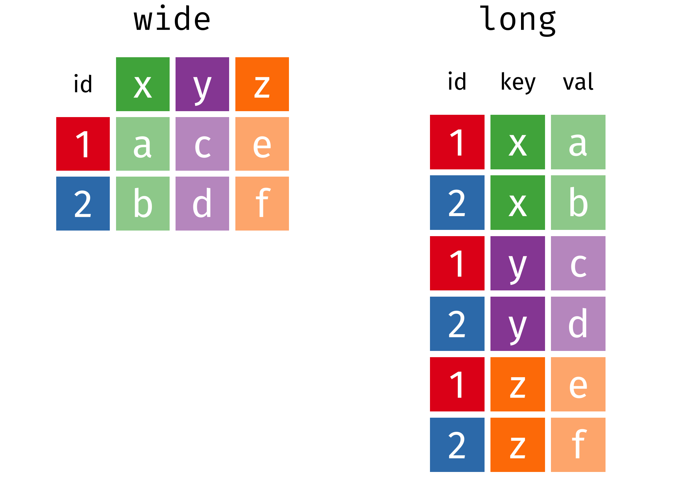
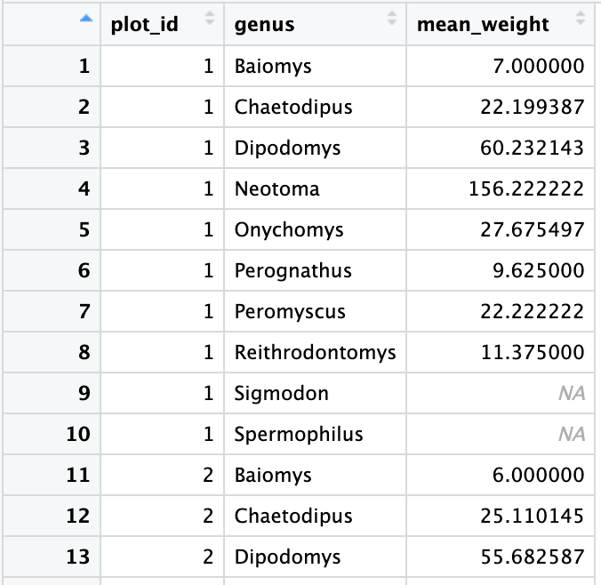
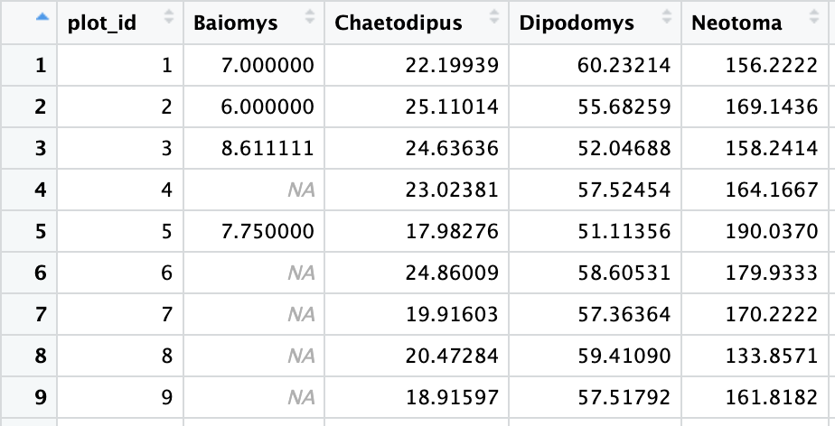
Tidyr: Wide vs. Long Format

Slide 26
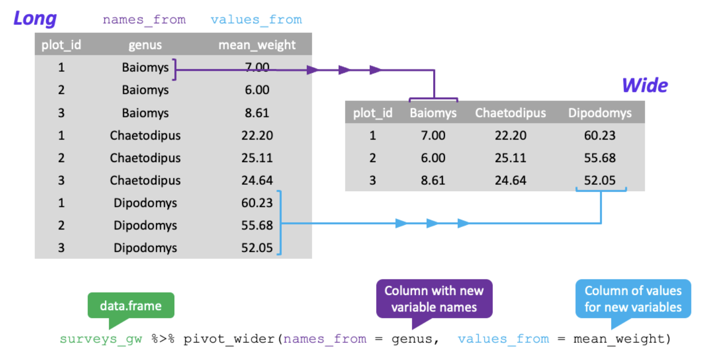
Tidyr: Pivoting from long to wide format

Slide 27
Tidyr: Pivoting from long to wide format
Firstly, filter our observations and variables of interest and create a new variable for the mean_weight
surveys_gw <- surveys %>%
filter(!is.na(weight)) %>%
group_by(plot_id, genus) %>%
summarize(mean_weight = mean(weight))
Pivoting from long to wide
surveys_wide <- surveys_gw %>%
pivot_wider(names_from = genus, values_from = mean_weight)

Slide 28
Run chunk 21-22

Slide 29
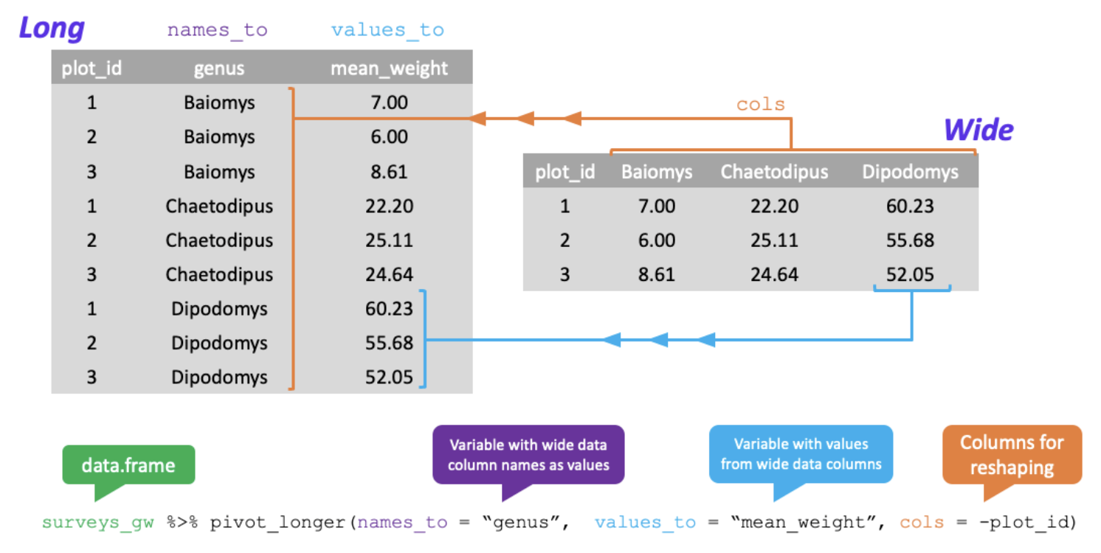
Tidyr: Pivoting from wide to long format

Slide 30
Tidyr: Pivoting from wide to long format
Pivoting from wide to long
surveys_wide <- surveys_gw %>%
pivot_longer(names_to = “genus”, values_to = “mean_weight”, cols = -plot_id)

Slide 31
Run chunk 23 Done!

Slide 32
Add in left, right, full join??

Slide 33
Questions

Slide 34
Q1: Using pipes, subset the surveys data to include animals collected before 1995 and retain only the columns year, sex, and weight. Surveys %>% filter(year < 1995) %>% select(year, sex, weight)

Slide 35
Q2: Create a new data frame from the surveys data that meeting the following criteria: contains only the species_id column and a new column called hindfoot_cm contain the hindfood_length values (currently in mm) converted to centimeters. In this hindfoot_cm column, there are no NAs and all values are less than 3. Surveys %>% filter(!is.na(hindfoot_length)) %>% mutate(hindfoot_cm = hindfoot_length / 10) %>% filter(hindfoot_cm < 3) %>% select(species_id, hindfoot_cm)

Slide 36
Q3: How many animals were caught in each plot_type surveyed? surveys %>% count(plot_type) Use group_by() and summarize () to find the mean, min, max hindfoot length for each species (using species_id). Also the number of observations (hint: see ?n) surveys %>% filter(!is.na(hindfoot_length)) %>% group_by(species_id)%>% summarize( mean_hindfoot_length = mean(hindfoot_length), mean_hindfoot_length = min(hindfoot_length), mean_hindfoot_length = max(hindfoot_length), n = n() )

Slide 37
Q3 continued: What was the heaviest animal measured in each year? Return columns year, genus, species_id and weight. surveys %>% filter(!is.na(weight)) %>% group_by(year)%>% filter(weight == max(weight)) %>% select(year, genus, species, weight) %>% arrange(year)

Slide 38
Q4: Reshape the surveys data frame with year as columns, plot_id as rows, and the number of genera per plot as the values. You will need to summarize before reshaping, and use the function n_distinct() to get the number of unique genera within a particular chunk of data. It’s a powerful function! See ?n_distinct for more. surveys_wide_genera <- surveys %>% group_by(plot_id, year)%>% summarize(n_genera = n_distinct(genus)) %>% pivot_wider(names_from = year, values_from = n_genera)

Slide 39
Q4: Now take that data frame and pivot_longer() it, so each row is a unique plot_id by year combination. surveys_wide_genera <- surveys %>% pivot_longer(names_to = “year”, values_to = “n_genera”, cols = -plot_id)

